Slide 1

Data 2204-03-Statistical Predictive Modelling – II final Project –finding Best Wheat Type
Student Name: Vinod Kumar Dhanavath. Student ID: 100947989.

Slide 2

Rational Statement:
In this analysis, we will address the challenge of classifying wheat types based on various features in the WheatData.csv dataset. The dataset consists of 210 observations with eight variables, including area, perimeter, compactness, and kernel length, among others. The goal is to accurately forecast the type of wheat—Kama, Rosa, or Canadian—using machine learning models.
Why It Matters:
Agricultural Quality Control: Accurate classification helps in the quality control of wheat, ensuring that the correct type is identified for its intended use, whether for baking, milling, or other purposes.
Market Value: Different wheat types may have varying market values. Proper classification ensures fair pricing and appropriate distribution.
Decision Support: This analysis provides critical insights for agriculturalists and food industry professionals in making informed decisions about wheat handling and processing.
By optimizing both Decision Tree and Random Forest models, this project aims to enhance the accuracy and reliability of wheat-type classification, ultimately benefiting stakeholders across the agricultural sector.

Slide 3
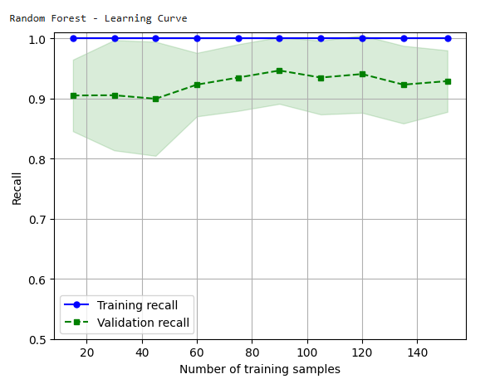
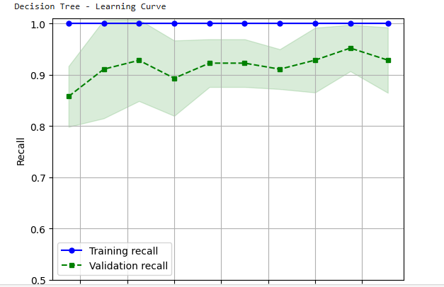
Learning Curve for Random Forest & Decision Tree
Learning Curve Random Forest
Learning Curve Decision Tree
The Random Forest model demonstrates strong performance with high recall (around 0.95-1.0) and low variance, indicating effective capture of positive instances and good generalization. While the model is stable, a slight improvement in recall (potentially up to 0.05) might be achievable with additional data.
Decision Tree Model: High recall (around 0.95-1.0) but significant overfitting is observed. The training recall is consistently high, while the validation recall fluctuates and is lower, indicating the model struggles to generalize to unseen data. Consider increasing training data or exploring other models to improve performance.

Slide 4
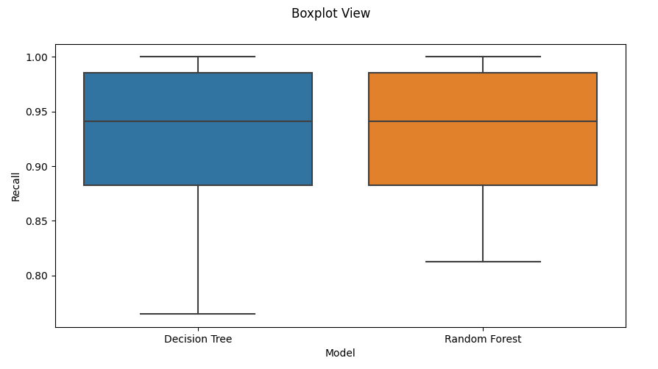
Model Analysis - Output Metrics
Model Evaluation - Recall :
In this section, we evaluate the performance of the Decision Tree and Random Forest models using recall as the primary metric. Recall measures the proportion of actual positive cases that were correctly identified by the model. This is crucial for understanding how well the models perform in identifying each wheat type.
Recall Scores
Model | Recall (Mean) | Standard Deviation
Decision Tree | 0.94 | 0.05
Random Forest | 0.93 | 0.05
Decision Tree:
Recall: 0.94
Standard Deviation: 0.05
Insight: The Decision Tree model shows a high recall, indicating it is very effective at correctly identifying wheat types, especially for the minority classes.
Random Forest:
Recall: 0.93
Standard Deviation: 0.05
Insight: The Random Forest model also demonstrates strong recall, slightly lower than the Decision Tree but still very effective. The consistency in performance is reflected in the low standard deviation.
Key Insights:
High Recall for Both Models: Both models exhibit high recall scores, indicating effective identification of wheat types.
Slight Edge for Decision Tree: The Decision Tree model has a marginally higher recall compared to Random Forest, which could be due to its ability to handle smaller datasets and fewer features more efficiently.
Reliability: The low standard deviation for both models suggests consistent performance across different subsets of the data, reinforcing their reliability.

Slide 5
Classification Report Analysis
Classification Report - Decision Tree Classifier
The Classification Report provides detailed metrics for each model, including precision, recall, f1-score, and support. These metrics help us understand the performance of each model in classifying the three wheat types: Kama, Rosa, and Canadian.
Classification Report:
Key Insights:
High Recall for Kama and Canadian:
The Decision Tree model demonstrates high recall for Kama (0.93) and Canadian (0.93), indicating it is highly effective at correctly identifying these classes.
This suggests the model is particularly good at detecting these wheat types, minimizing false negatives.
Balanced Precision and Recall for Rosa:
Precision for Rosa is 0.92, while recall is slightly lower at 0.86. This balance suggests that while the model is good at identifying Rosa, there is room for improvement in reducing false negatives.
The f1-score for Rosa (0.89) reflects this trade-off.
Outstanding Performance for Canadian:
The Canadian class has perfect precision (1.00) and high recall (0.93), resulting in the highest f1-score (0.96).
This indicates that the Decision Tree model is exceptionally good at identifying Canadian wheat with minimal errors.
Class | Precision | Recall | F1-Score | Support
Kama | 0.81 | 0.93 | 0.87 | 14
Rosa | 0.92 | 0.86 | 0.89 | 14
Canadian | 1 | 0.93 | 0.96 | 14
Accuracy |  |  | 0.9 | 42
Macro Avg | 0.91 | 0.9 | 0.91 | 42
Weighted Avg | 0.91 | 0.9 | 0.91 | 42

Slide 6
Classification Report Analysis
Classification Report -Random Forest Classifier
The Classification Report provides detailed metrics for each model, including precision, recall, f1-score, and support. These metrics help us understand the performance of each model in classifying the three wheat types: Kama, Rosa, and Canadian.
Classification Report:
Perfect Recall for Canadian:
The Random Forest model achieves a perfect recall of 1.00 for Canadians, indicating it can perfectly identify this class without any false negatives.
This shows superior performance in recognizing Canadian wheat.
Overall High Performance:
The model achieves high precision, recall, and f1-scores across all classes, with an overall accuracy of 0.93.
This reflects the model’s robustness and reliability in classification tasks.
Balanced and Reliable Metrics:
The balanced metrics across classes suggest that the Random Forest model performs consistently well without favouring any particular class.
The model's high weighted average f1-score (0.93) demonstrates its effectiveness in handling imbalanced classes.
Class | Precision | Recall | F1-Score | Support
Kama | 0.87 | 0.93 | 0.9 | 14
Rosa | 0.92 | 0.86 | 0.89 | 14
Canadian | 1 | 1 | 1 | 14
Accuracy |  |  | 0.93 | 42
Macro Avg | 0.93 | 0.93 | 0.93 | 42
Weighted Avg | 0.93 | 0.93 | 0.93 | 42

Slide 7
Feature Importance Analysis
Feature Importance for Decision Tree Classifier:
Key Insights:
Dominant Feature: LKG (Length of Kernel Groove):
The feature LKG has the highest importance score of 0.55, indicating it is the most significant predictor in the Decision Tree model.
This suggests that the length of the kernel groove is crucial for distinguishing between different wheat types.
Less Significant Features:
Features such as P (Perimeter), C (Compactness), and LK (Length of Kernel) have very low importance scores, indicating they contribute minimally to the model’s decisions.
This reflects that the Decision Tree model relies more on the A, WK, and LKG features.
Feature Selection Implications:
The high importance of LKG and A may guide feature selection in future models, potentially simplifying the feature set while retaining performance.

Slide 8
Feature Importance Analysis
Feature Importance for Random Forest Classifier:
Key Insights:
Important Features: A and LKG:
A (Area) and LKG have the highest importance scores (0.22 and 0.23, respectively), showing they are key predictors in the Random Forest model.
This indicates that these features are critical for the model’s decision-making process.
Balanced Feature Contribution:
The Random Forest model assigns relatively balanced importance to most features, with no single feature dominating.
This suggests that multiple features contribute to the model’s performance, offering a more comprehensive view of the data.
3. Model Robustness:
The relatively balanced feature importance reflects the Random Forest's ability to utilize various features for improved classification.
This balance can be advantageous in scenarios where features contribute differently across various instances.

Slide 9

Recommendations for Mr. John Hughes:
Recommendation 1: Consider Model Performance and Feature Importance
Action: Focus on the most important features identified by the models (LKG and A in the Random Forest, and LKG in the Decision Tree).
Reason: These features significantly impact model accuracy and can be used to streamline feature selection or improve future model iterations.
Outcome: Enhancing model performance by concentrating on critical features can lead to more efficient and effective predictions.
Recommendation 2: Leverage Random Forest for Enhanced Accuracy
Action: Given the Random Forest model's higher accuracy (0.93) and balanced feature importance, it should be preferred over the Decision Tree model for operational use.
Reason: Random Forest's ensemble approach tends to provide better generalization and reliability compared to a single Decision Tree.
Outcome: Implementing the Random Forest model can improve the overall accuracy and robustness of wheat-type classification.
Recommendation 3: Explore Further Hyperparameter Tuning
Action: Continue experimenting with additional hyperparameters and advanced techniques (e.g., grid search or randomized search) to optimize both models further.
Reason: Even though current models are well-optimized, further tuning can potentially enhance performance and provide better insights into model behavior.
Outcome: Improved model performance and better alignment with specific business needs or constraints.

Slide 10
Conclusion or Summary :
Summary of Findings:
Model Performance:
Random Forest: Achieved a higher accuracy of 93%, demonstrating better overall performance compared to the Decision Tree model.
Decision Tree: Showed a slightly lower accuracy of 90%, but remains a valuable model due to its interpretability.
Key Insights:
Feature Importance:
For both models, LKG (Length of Kernel Groove) and A (Area) are crucial features influencing classification.
The Random Forest model provides a more balanced view of feature importance, while the Decision Tree highlights LKG as the dominant feature.
Model Choice:
The Random Forest model is recommended for its superior performance and robustness, but the Decision Tree offers a simpler and more interpretable approach.
Recommendations:
Focus on key features identified by the models for future improvements.
Prefer the Random Forest model for practical use due to its higher accuracy and robustness.
Explore additional hyperparameter tuning for potential performance enhancements.
Final Thoughts:
The analysis provides valuable insights into wheat classification, enabling more accurate and informed decision-making.
Both models offer useful perspectives, with the Random Forest model standing out in terms of performance.
Continuous refinement and validation of models will further enhance their effectiveness and applicability.

Slide 11
Reference:
https://durhamcollege.desire2learn.com/d2l/le/content/551696/viewContent/7647376/View

